Slide 1


CSE (H) with specialization in Machine Learning and Artificial Intelligence
Soft Computing
Chapter -1.1
Introduction to soft computing
By: Dr. Monika Singh E11032
DISCOVER . LEARN . EMPOWER

Slide 2
Course Objectives
To introduce soft computing concepts and techniques of artificial neural networks, fuzzy sets, fuzzy logic and genetic algorithms
To understand the various techniques from the application point of view.
To analyze various soft computing techniques and decide the technique to be used in a particular problem situation.
To implement soft computing based solutions for real-world problems

Slide 3
Course Outcomes
CO1 | Identify and describe soft computing techniques and their roles in building intelligent. Machines | 1
CO2 | Recognize the feasibility of applying a soft computing methodology for a particular problem. | 2,4
CO3 | Apply fuzzy logic and reasoning to handle uncertainty and solve engineering problems, genetic algorithms to combinatorial optimization problems and neural networks to pattern classification and regression problems. | 3
CO4 | Effectively use modern software tools to solve real problems using a soft computing approach. | 3
CO5 | Evaluate various soft computing approaches for a given problem. | 4

Slide 4
Table of Contents
Introduction to soft computing
Difference Between Soft computing and Hard Computing
Major Areas of Soft Computing
Applications of soft computing

Slide 5
Goals of Soft Computing
The main goal of soft computing is to develop intelligent machines to provide solutions to real world problems, which are not modeled, or too difficult to model mathematically.
It’s aim is to exploit the tolerance for Approximation, Uncertainty, Imprecision, and Partial Truth in order to achieve close resemblance with human like decision making.

Slide 6
Applications of Soft Computing
Communication
Home Appliances
Robotics
Transportation
Healthcare

Slide 7
Communication
Communication requires a very dynamic environment as the demand can occur randomly, and most of the time, there is not much of a pattern to work with.
Soft computing uses an artificial neural network and fuzzy logic to determine when there is a sudden surge in demand and accordingly allocates resources for that particular node.
Not only does it help save cost through reduced usage, but also helps save substantial resources that can be diverted to other areas that currently demand higher bandwidth.

Slide 8
Consumer Appliances
The field of consumer appliances activities is associated to practical product development. There is a huge scope of fuzzy logic, neural networks which have already brought artificial intelligence in home appliances.
More recently, evolutionary computation has also shown remarkable identity in this field. These techniques are used for various applications like washing machines, heaters, refrigerators, microwaves and many more.

Slide 9
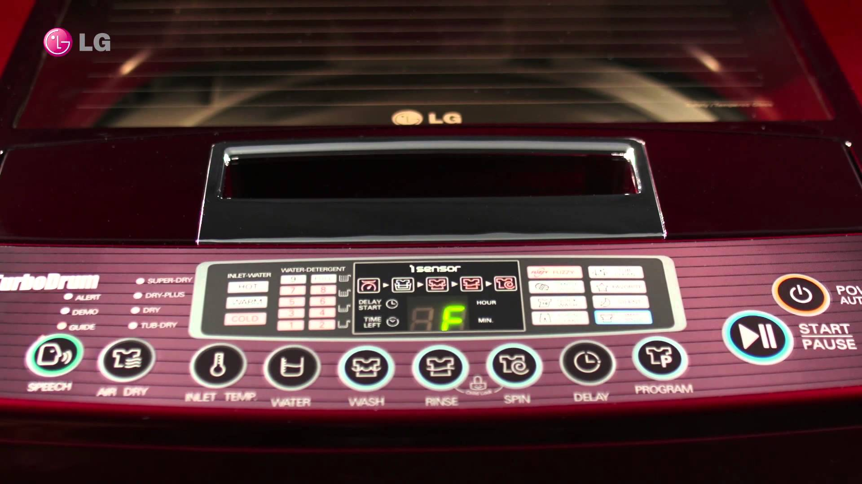
Fuzzy logic washing machines are gaining popularity.
These machines offer the advantages of performance, productivity, simplicity, and less cost.
Sensors continually monitor varying conditions inside the machine and accordingly adjust operations for the best wash results. As there is no standard for fuzzy logic, different machines perform in different manners.

Slide 10
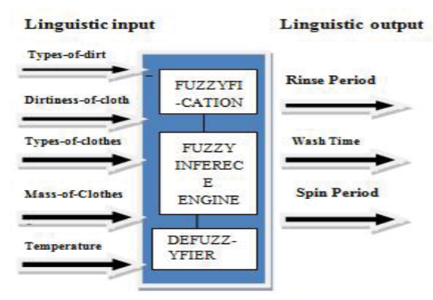
Factors for Fuzzy Logic
No two Fuzzy Logic systems are alike, and brands typically vary the parameters sensed in the washing machine. The following are usually the variables taken into consideration:
The weight of the load
The type of fabric
The amount and temperature of the water
The amount of detergent
The dirt in the water or rinse needs

Slide 11
Advantages This optimizes the life span of the washing machine. Some machines even learn from past experience, memorizing programs and adjusting them to minimize running costs.

Slide 12
Robotics
This is one of the very upcoming fields to use soft computing’s fuzzy logic and expert systems techniques.
It helps manage industries efficiently in not only production but also inventory management.
Some of the large e-commerce companies are already employing robots with soft computing embedded to help manage the substantial load of goods that goes through the warehouse on a daily basis.

Slide 13
Healthcare
No one would have guessed this as an application since it’s such a critical industry.
One wrong decision can result in loss of lives or permanent damage to the patients.
But soft computing, using a horde of its various logic has been found to be quite accurate in terms of diagnosis and results.
Doctors are increasingly turning towards soft computing to diagnose the patients’ ailments from the symptoms accurately and hence save on money and side effects from medications of the wrong diagnosis.

Slide 14
Summary
As the development of soft computing flourish day by day, the application areas will also be felt increasing in coming years. Soft computing based products are increasing day by day. Majority of such products uses any of the soft computing technique inside the sub systems which are not known to end user. The gist is that, soft computing techniques will become common to various applications and has ability to deal with imprecise problems.

Slide 15
Questions…
Give real time examples where soft computing is applicable?
How soft computing differs from hard computing?

Slide 16
References
Book:
S.N.Sivanandam, S.N Deepa, “Principles of Soft Computing”
Websites:
https://nptel.ac.in/courses/106/105/106105173/
Videos:
https://www.youtube.com/watch?v=mlfM4SGOAgo
https://onsitego.com/blog/best-samsung-fridge-glossary-ever/
Journal Paper : https://www.sciencedirect.com/science/article/pii/S1877050916325467

Slide 17

THANK YOU
For queries
Email: monika.e11032@cumail.in

